Slide 1
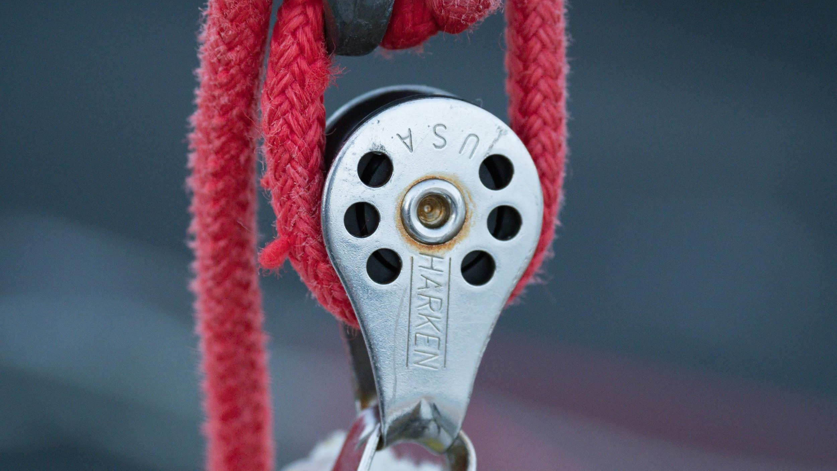
PULLEYS
We will explain pulleys using forces
Notes:
Insert cover image and use transparency settings to fade image.

Slide 2
Do not delete this slide.
This slide is designed so that you can copy the prompt box you need and insert it into your slides.
This slide is hidden and will not be included when presenting your lesson.
TRACK WITH ME
VOCABULARY
1 -
HINT
Students, remember….
CHECK FOR UNDERSTANDING
READ WITH ME
TEACHER CUE
MAKE THE CONNECTION
Students, you already know….
EXTENSION
GESTURE WITH ME

Slide 3
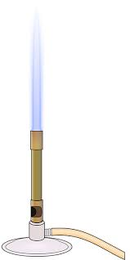
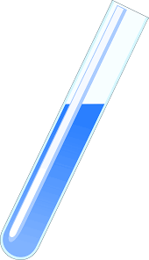
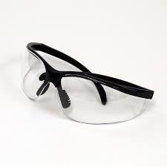
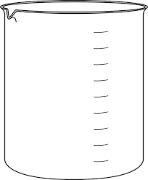
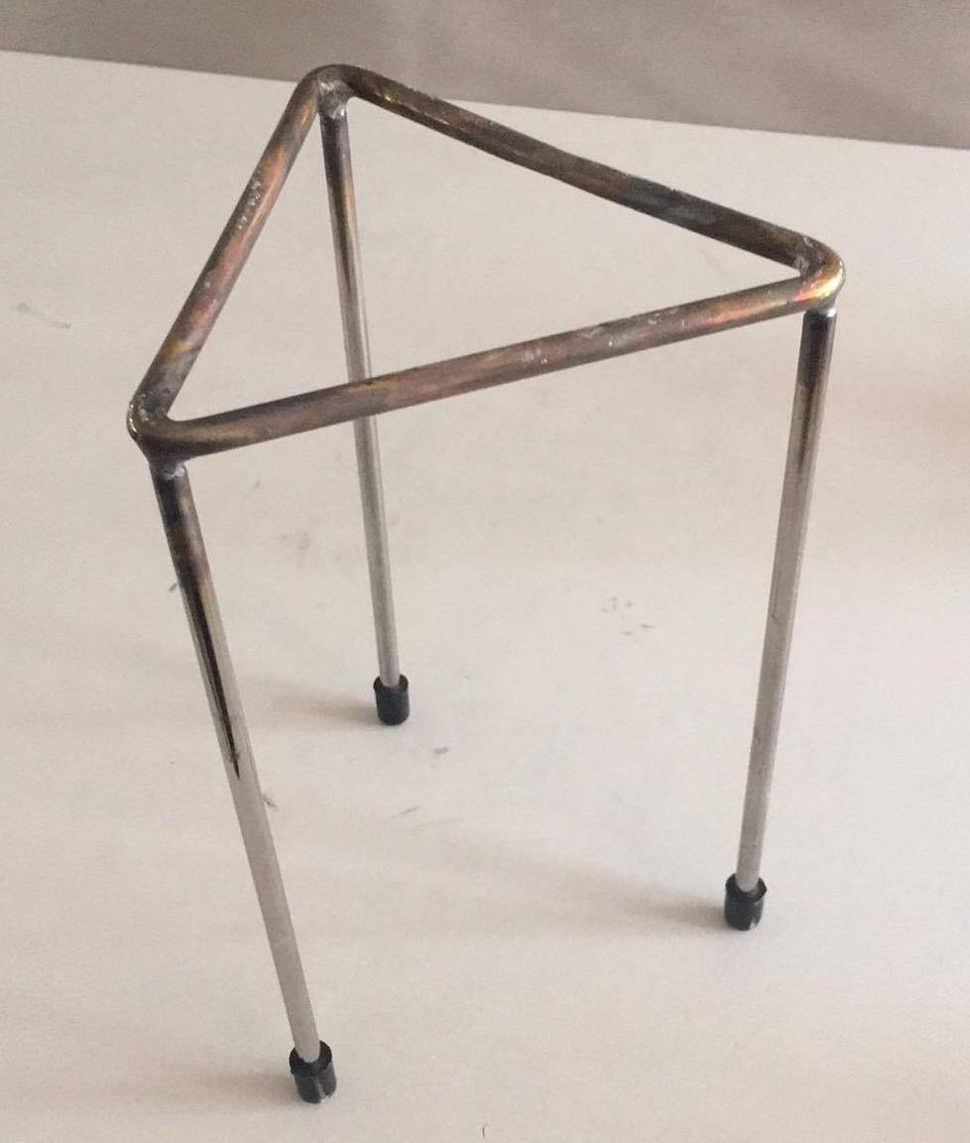
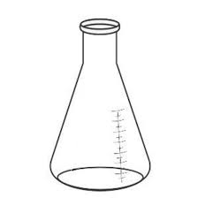
Name the pieces of science equipment:
A B C D
E F
Conical flask
Safety glasses
Bunsen Burner
Test Tube
Beaker
Tripod

Slide 4
Repeat the opposite word/phrase.
SIMPLE MACHINE
DEVICE REDUCING EFFORT NEEDED

Slide 5
Repeat the opposite word/phrase.
LEVER
ROD SUPPORTED AT A POINT

Slide 6
Repeat the opposite word/phrase.
FULCRUM
TURNING POINT OF LEVER

Slide 7
Repeat the opposite word/phrase.
EFFORT
FORCE APPLIED TO LEVER

Slide 8
Draw the diagram below on your whiteboard but label each letter using the list below.
Lever
Load
Effort
Fulcrum
A
B
C
D

Slide 9
We will explain pulleys using forces
TRACK WITH ME
READ WITH ME
• We will define pulley.
• We will draw the effect of pulleys on forces using familiar examples.
DECLARE THE OBJECTIVE
Read the learning objective to your partner.
Notes:
Learning Objectives contain concepts (nouns, big ideas), skills (verbs, measurable behaviours) and sometimes context (restricting or targeting conditions).
●Example: Students will be able to describe the concept of density and apply it to floating and sinking.
●
Success criteria are specific measurable outcomes that if met mean that the student has met the learning objective.
Examples:
•Students will be able to compare densities of substances using mass and volume.
•Students will be able to identify whether a solid or liquid will float or sink in a liquid based on their densities.

Slide 10
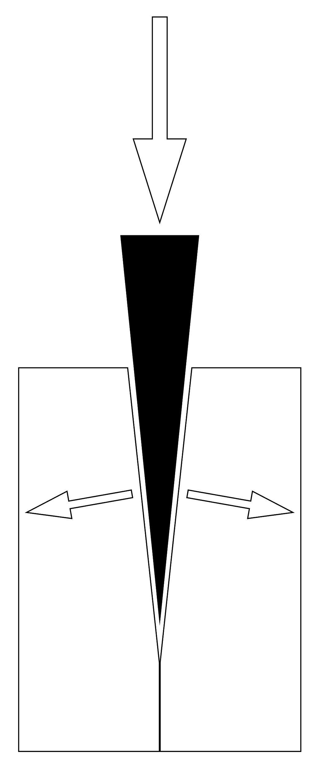
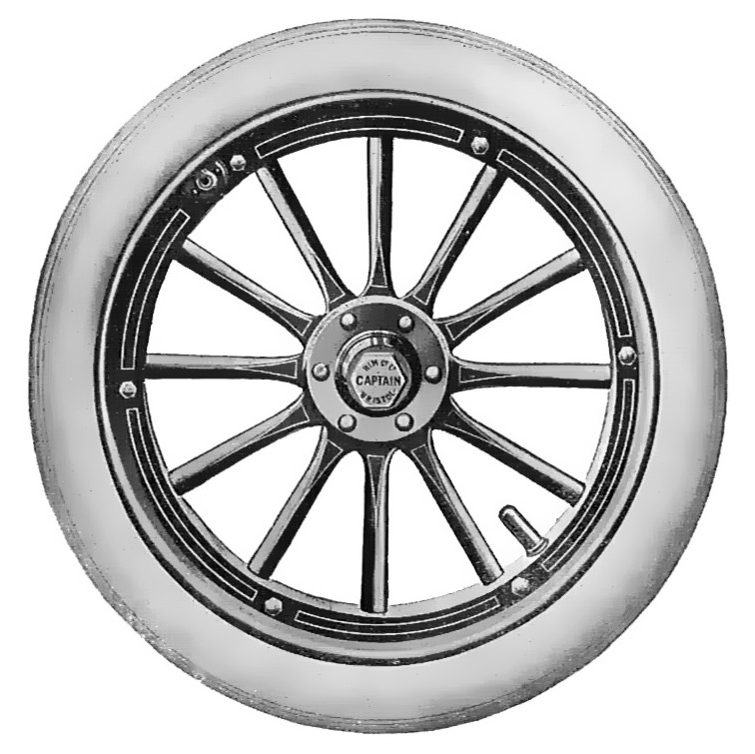
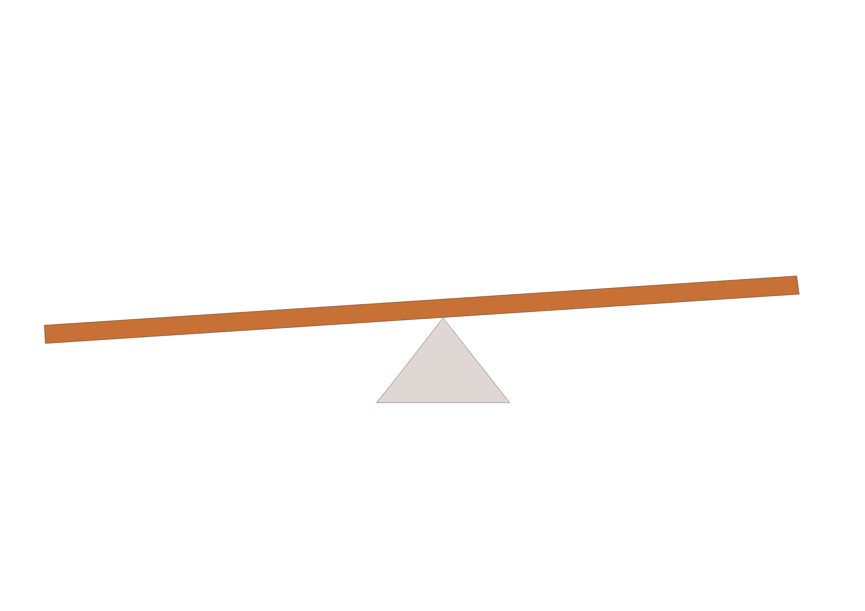
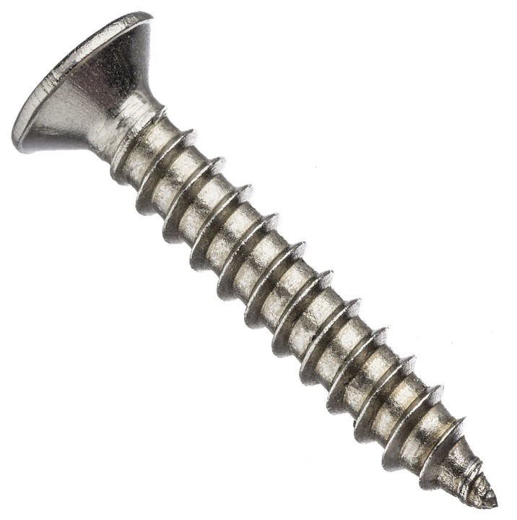
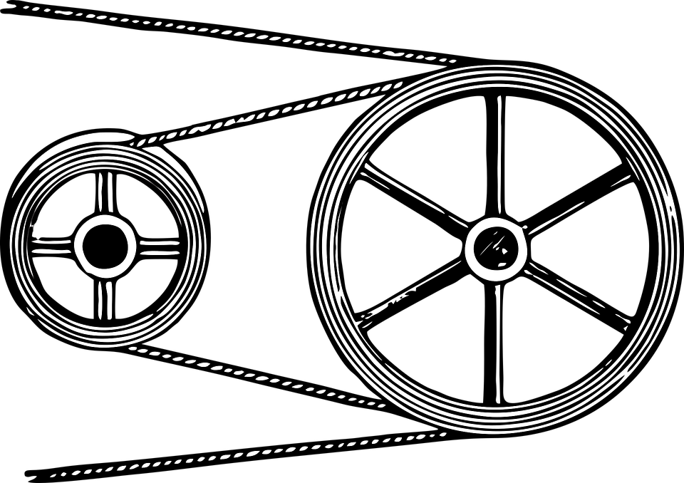
We will explain pulleys using forces
Simple machines are devices₁ which make a task easier to do.
The task becomes easier by changing the size, direction or speed of a force.
What objects can you think of that make performing tasks easier?
Levers Pulleys Screws
Wedges
Wheels
VOCABULARY
1 - object

Slide 11
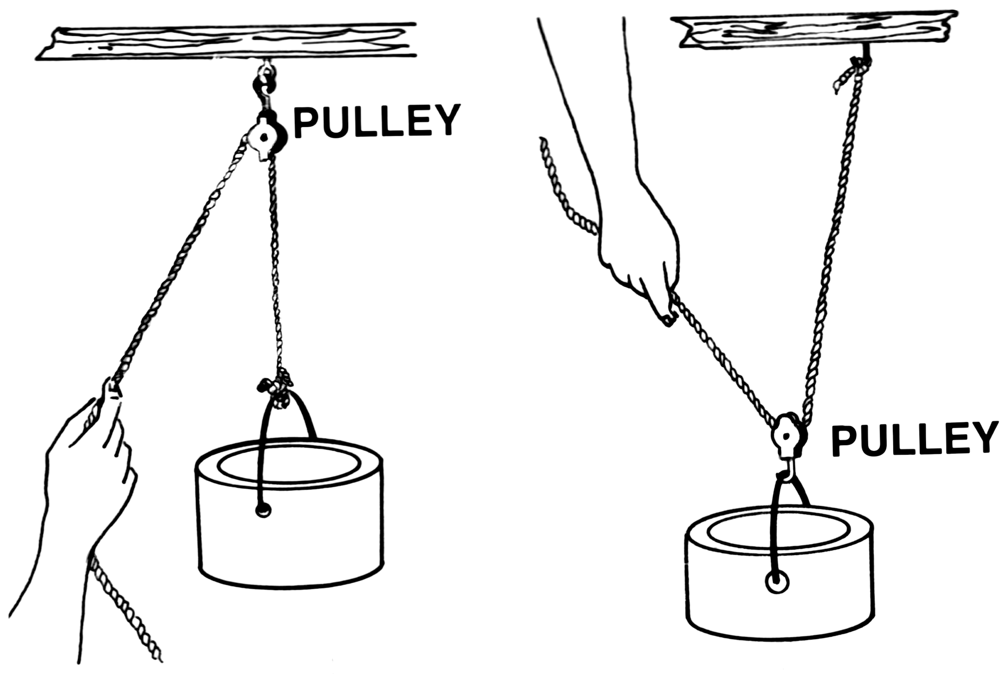
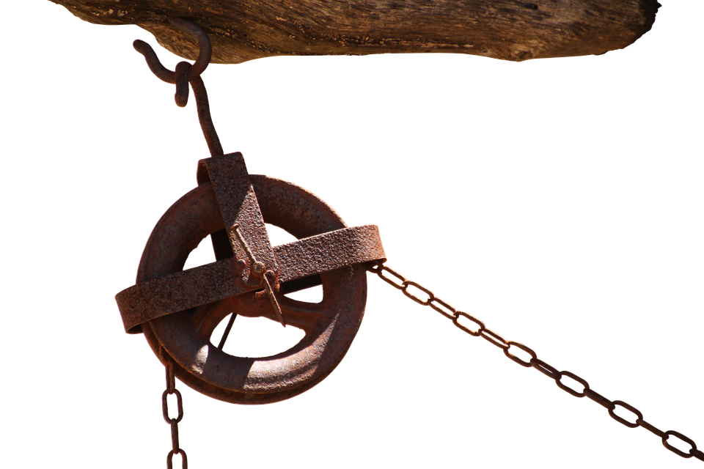
We will describe pulleys using forces
CHECK FOR UNDERSTANDING
Which simple machines change the direction of forces? First and Second-Class Levers Pulleys Third-Class Levers What is a puller? What does it do?
Simple machines can be used to change the direction of a force.
A pulley is a wheel with a groove₁ around it where a chain or rope can move.
Pulleys change the direction of the force.
For example when the person in
this picture pulls down on the
rope, the bucket is pulled up.
DEFINITION
1 - long, thin cut

Slide 12

We will describe pulleys using forces
Simple machines can be used to change the direction of a force.
Pulleys change the direction of the force.
This can help us because it may be easier to pull down than pull or push something
up.
They allow us to move things
that could otherwise be too
heavy.
CHECK FOR UNDERSTANDING
We use pulleys to raise flags on poles. What happens to the flag as the rope is pulled down?

Slide 13
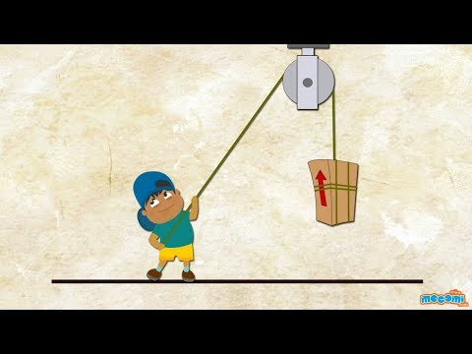
We will describe pulleys using forces
CHECK FOR UNDERSTANDING
What does a pulley do? Why does the rope have to be longer when you add more pulleys?

Slide 14
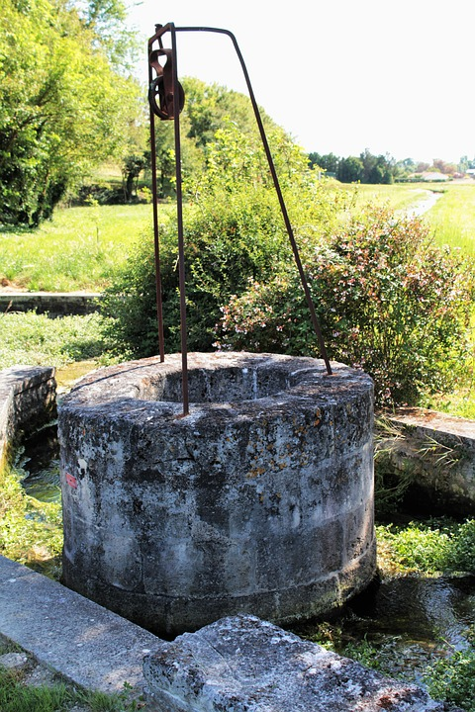
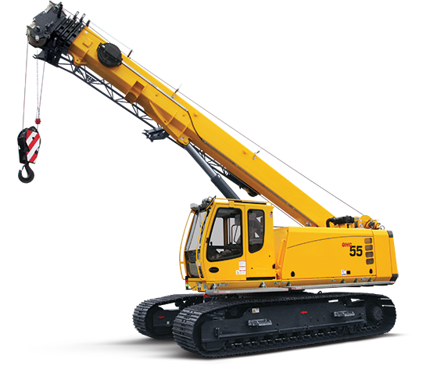
We will describe pulleys using forces
CHECK FOR UNDERSTANDING
Why are pulleys used for wells? Hint: think effort
Simple machines can be used to change the direction of a force.
Pulleys change the direction of the force.
They allow us to move things that could otherwise be too heavy by reducing the effort₁ force required.
Pulleys are used by cranes, on
sailing boats, in elevators and
in weight lifting equipment.
DEFINITION
1 - the amount of force to lift or move the object

Slide 15
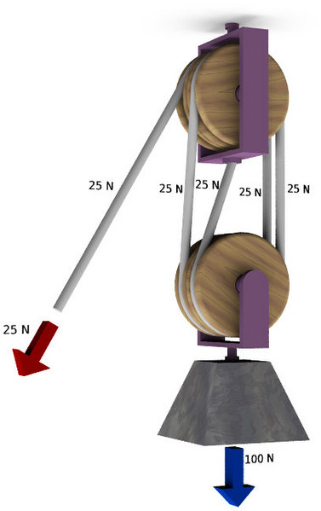
We will describe pulleys using forces
Simple machines can be used to change the direction of a force.
Pulleys change the direction of the force.
We can add additional₁ pulleys to decrease the effort₁ force.
The more pulleys added the less effort force needed to do something.
CHECK FOR UNDERSTANDING
Which amount of pulleys would use the least amount of effort force to do something? two three four
DEFINITION
1 - the amount of force to lift or move the object

Slide 16
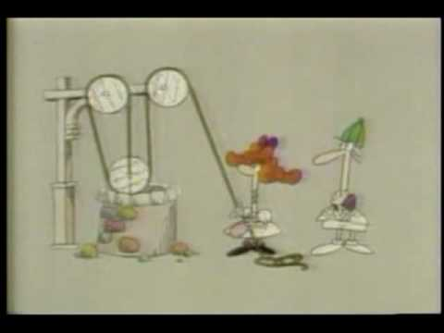
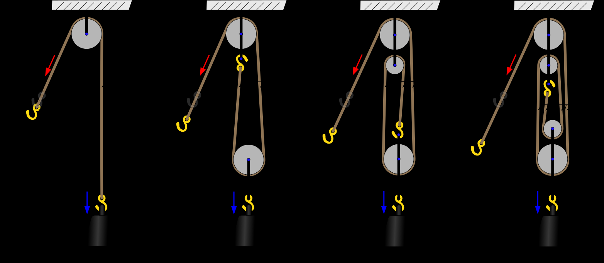
We will describe pulleys using forces
The more pulleys added the less effort force needed to do something.
Pulleys multiply the effort force.
CHECK FOR UNDERSTANDING
Why does adding pulleys reduce the effort force needed?

Slide 17
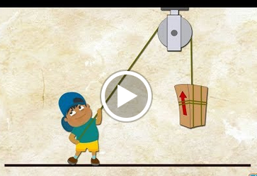

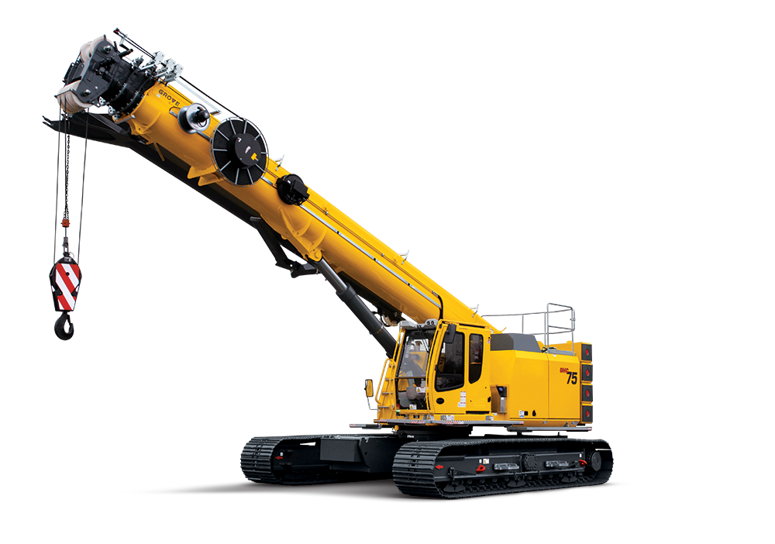
We will describe pulleys using forces
REMEMBER THE CONCEPT
Remember the two simple machines we’ve covered so far. They are levers, and pulleys.
Complete the table below.
Example | Which simple machine would you use? | Draw a diagram of the simple machine
Lifting a bucket of water from a well
Using a screwdriver to open a paint tin
Crane lifting building materials
Raising a flag

Slide 18
We will describe pulleys using forces
Pulleys are used in elevators, cranes, window curtains and window blinds.
Changing the direction of forces can be very useful as you can use forces like gravity help you.
CHECK FOR UNDERSTANDING
How can we use pulleys to multiply our effort force? All pulleys multiply the effort force Add additional pulleys Ask someone to help you pull

Slide 19
We will describe pulleys using forces
Simple machines are devices which make a job easier to do.
Pulleys are simple machines which change the direction of forces.
Pulleys are wheels with a groove₁ which allows a chain or rope to move around it.
Additional₂ pulleys can reduce the effort force needed. They multiply the force applied.
CHECK FOR UNDERSTANDING
If someone was using a pulley to pull upwards, what direction would the pulley change the direction to be? Up Sideways Down
DEFINITION
1 - long, thin cut 2 - more

Slide 20
We will explain pulleys using forces
Draw a diagram of a pulley showing the force changing direction.
Complete the following sentences
Pulleys change the ________ of a force.
_______ pulleys can ________ the effort force needed.
List three examples of what pulleys are used for in real life.
REMEMBER THE CONCEPT
Remember that wedges and pulleys are simple machines which change the direction of forces. More pulleys can reduce the effort force needed.
Notes:
Please include tasks/questions here rather than just referring to a worksheet. This will save on photocopying and facilitate sharing with other schools.
Try and build tasks/questions which escalate through Bloom’s Taxonomy. This will help with differentiation.

Slide 21
We will explain pulleys using forces.
• We will define pulley.
• We will draw the effect of pulleys on forces using familiar examples.
CHECK FOR UNDERSTANDING
Check Success Criteria.

